Slide 1

Amazon Internship
Instructor: Kelvin Sung
Manager: Kumar Akshay
Mentors: Thomas An & Sven Eberhardt
By: David Kim

Slide 2

What does Amazon do?
E-commerce
Cloud computing
Digital streaming
Artificial Intelligence

Slide 3

Helpful Courses
CSS 342 – Data Structures, Algorithms, and Discrete Math I
CSS 343 – Data Structures, Algorithms, and Discrete Math II
CSS 360 – Software Engineering
CSS 370 – Analysis and Design
CSS 430 – Operating Systems

Slide 4
Learnings & Experience

Slide 5
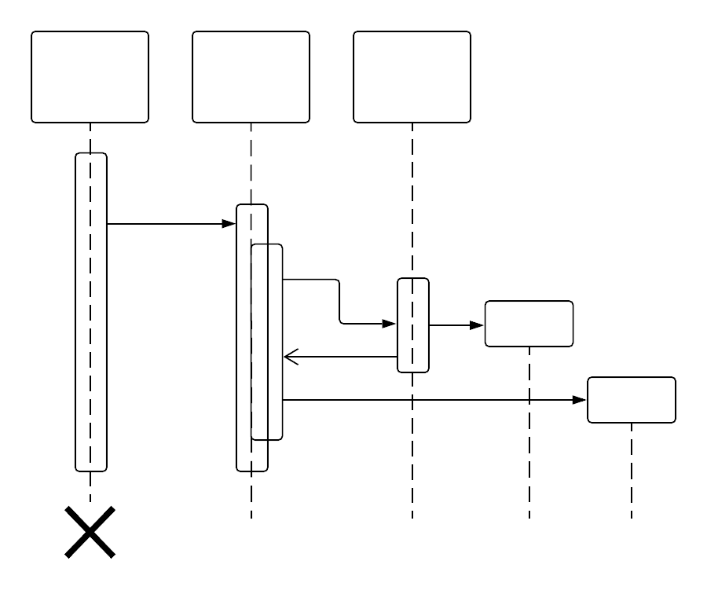
Creating a Design Document
Research required before creating a design document
Tools and techniques used for creating a good design document
Why design documents are important

Slide 6


Writing Code and Unit Tests
Java annotations
Testing with Junit 5 and Mockito
Inversion of Control & Dependency Injection
Pipelines
Writing Code Reviews

Slide 7

Participating in Scrum Meetings
Communicated with team members about project
Learned about other members and what they are working on
Created a consistent workflow of tasks using a Kanban board

Slide 8

AWS Cloud Development Kit
Useful tool for setting up AWS resources and services
Could write code to deploy and provision AWS services
Greatly sped up development process
Made development much more intuitive

Slide 9
Pitfalls

Slide 10

Pitfalls
I could have invested more time into learning about other members in the team outside the internship project.
I could have sped up development by asking more questions.
I missed opportunities to explore the culture and other areas at Amazon.

Slide 11
Conclusion

Slide 12
Overall Experience
Great experience working with my manager, mentor, and other colleagues.
Learned a lot about writing industry standard code.
Got hands on experience using many different AWS services, APIs, and many development tools.
Learned how to manage time and the importance of creating design documents and timelines.

Slide 13















Amazon Internship
David Kim | B.A. Computer Science & Software Engineering | Autumn 2020 | Instructor: Dr. Kelvin Sung | Manager: Akshay Kumar | Mentors: Thomas An & Sven Eberhardt
About Amazon
Experience
Tools & Services
Amazon is an American multinational technology company based in Seattle, Washington. Amazon is a great company that not only focuses on its products like e-commerce, cloud computing, digital streaming, and artificial intelligence, but also focuses on customers and providing a great customer experience.
Participated in team meetings and worked in a Scrum software development cycle.
Created a document and architecture design for the project.
Wrote code packages using Java and Typescript.
Tested code using Mockito and Junit 5
Gained experience using different kinds of AWS services.
What I Learned
Pitfalls
How to communicate with colleagues
Writing industry standard code and the importance of code reviews.
How to write test cases for testing code.
Using git and how to write a good git commit message.
Setting up AWS services and resources using the AWS Cloud Development Kit.
Inversion of Control and dependency injections.
Not spending time to engage with other team members outside of the internship project.
Waiting too long to ask for help.
Not communicating enough.
Courses
CSS 342 – DATA, ALG, & MATH I
CSS 343 – DATA, ALG, & MATH II
CSS 360 – Software Engineering
CSS 370 – Analysis and Design
CSS 430 – Operating Systems

Slide 14
Thank you

